Slide 1
Poetry of Brazil
Maša Miloš & Ana Beatriz do Carmo Garaj

Slide 2
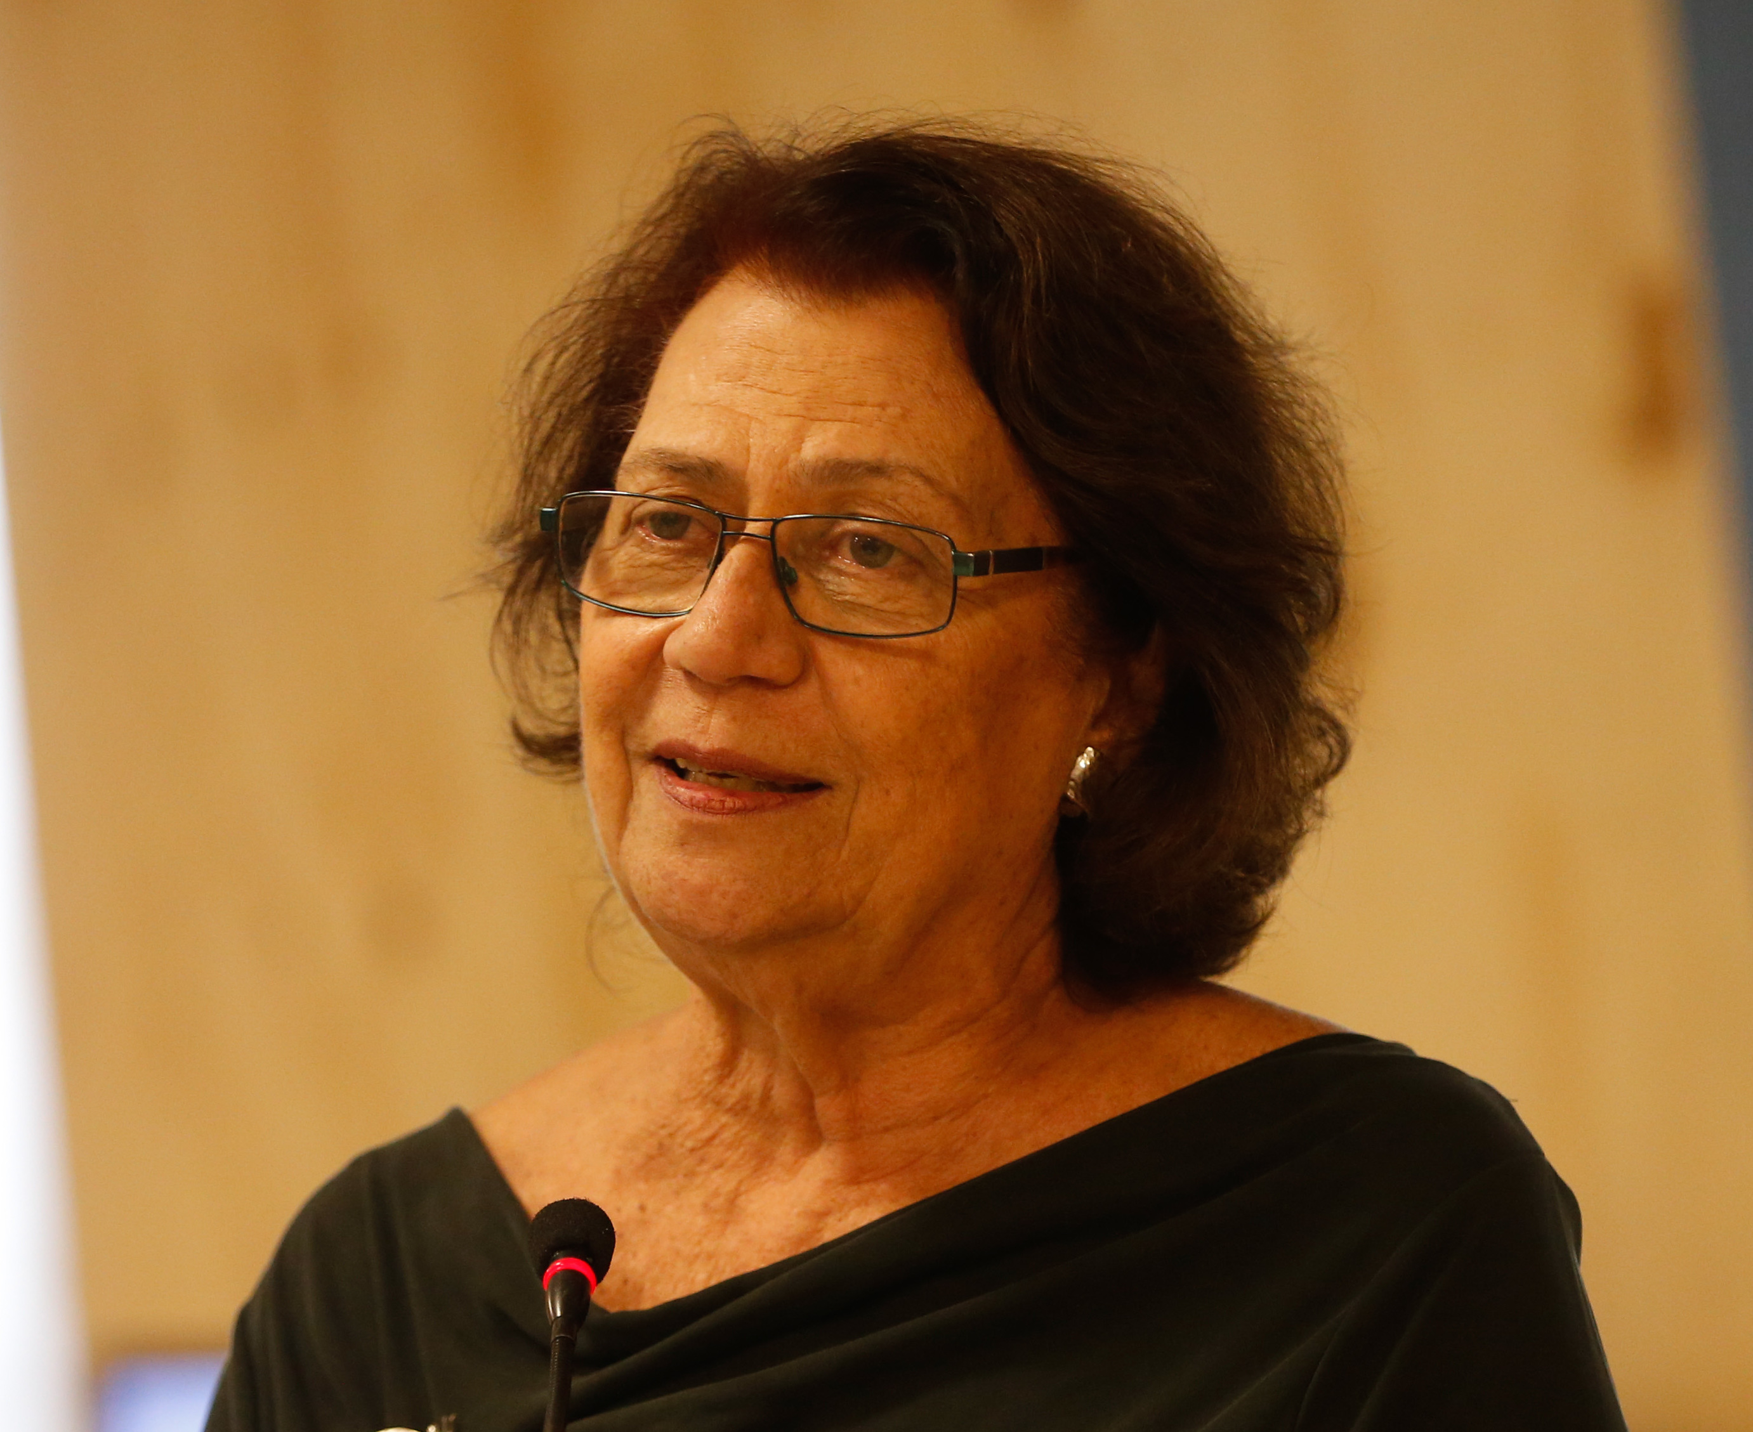
Ana Maria Machado
She was born in Rio de Janeiro, Brasil in 1941.
She started her career as a painter.
She worked as journalist for the magazine 'Elle' in Paris and the BBC in London.
In 1979, she opened the first children's bookshop in Brazil, 'Malasartes'.

Slide 3
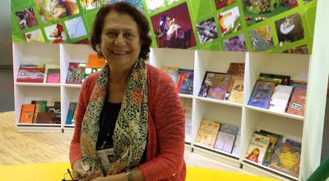
Ana Maria Machado
In 1969, Ana Maria Machado started to write.
She won the Hans Christian Andersen Award for Writing in 2000
Ana Maria Machado lives with her family in Rio de Janeiro.

Slide 4
Her books
Alice e Ulisses, (novel), 1983
Tropical Sol da Liberdade, (novel), 1988
Aos Quatro Ventos, (novel), 1993
A Audácia dessa Mulher, (novel), 1999
Para Sempre, (novel), 2001
Menina Bonita do Laço De Fita, (novel), 2011
Quando Eu Crescer, (novel), 2013
O Gato De Botas, (novel), 2018

Slide 5
Maresia, the poem
Maresia
Brisa na restinga
traz maresia
a onda respinga
a gota suspira
o ar que se inspira.
Nariz abre a asa
narina é casa
de aroma morar.
É o lar que inspira
é o mar que respira.
Maresia
Breeze on the sandbank
bring salty spray
the wave splashes
the drop sighs
the air that is inspired.
Nose opens the wing
nostril is home
of aroma to live.
It is the home that inspires
it is the sea that breathes.
By Ana Beatriz do Carmo Garaj

Slide 6
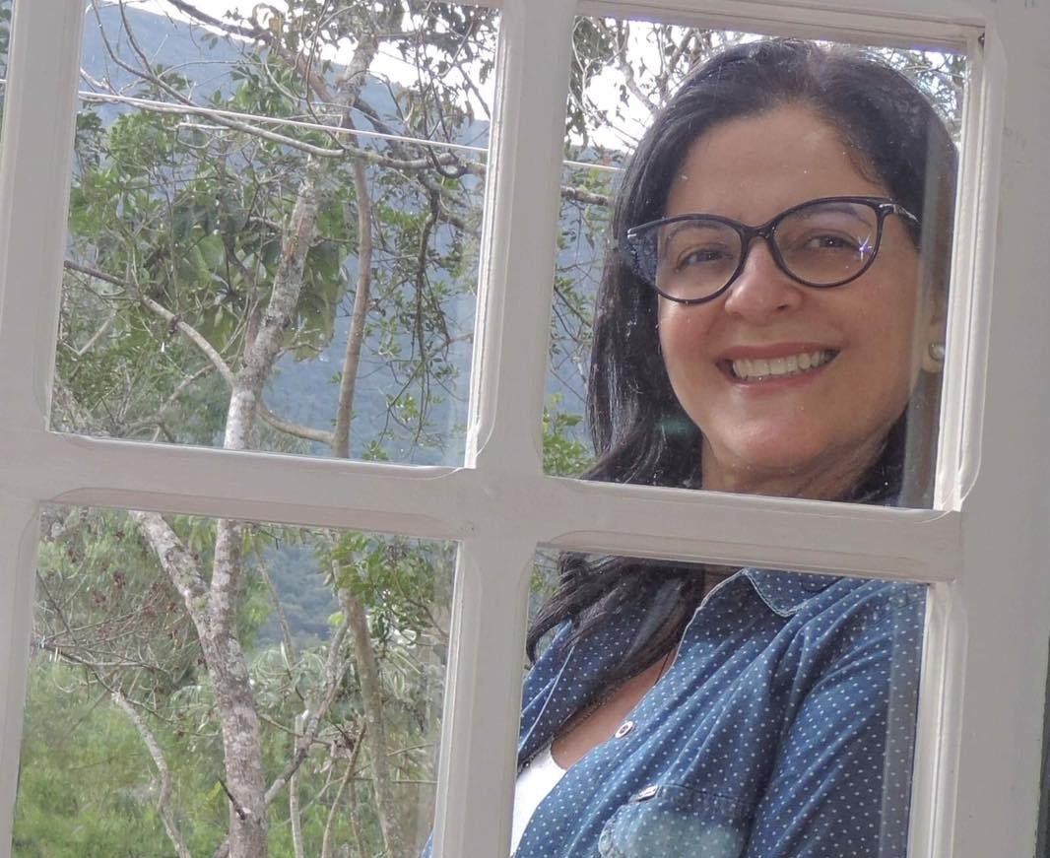
Jane Emirene Dias Carrihlo
Lives in Divinópolis, Brazil
Works as a Pedagogical Coordinator
Wrote one book of poems „Poesias e Musicas” with Neire de Sousa Araújo that includes poems:
Minha Escola, S.O.S Saúde, Pipoca, Tem pipoqueiro

Slide 7
Minha escola, the poem
Portuguese version
English version
Croatian version
By Ana Beatriz do Carmo Garaj

Slide 8
Thank you for your attention!

